Slide 1
1
FUNCTIONS AND LIMITS

Slide 2
1.1
Functions and Their Representations
.

Slide 3
Functions and Their Representations
Functions arise whenever one quantity depends on another. Consider the following two situations.
The area A of a circle depends on the radius r of the circle. The rule that connects r and A is given by the equation A = π r ². With each positive number r there is associated one value of A, and we say that A is a function of r.

Slide 4
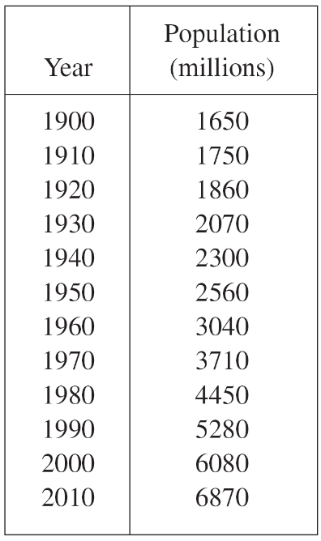
Functions and Their Representations
B. The human population of the world P depends on the time t. The table gives estimates of the world population P (t) at time t, for certain years.
For instance,
P (1950) ≈ 2,560,000,000
But for each value of the time t there is a corresponding value of P, and we say that P is a function of t.

Slide 5
Functions and Their Representations
C. The cost C of mailing a first-class letter depends on the weight w of the letter.
Although there is no simple formula that connects w and C, the post office has a rule for determining C when w is known.

Slide 6
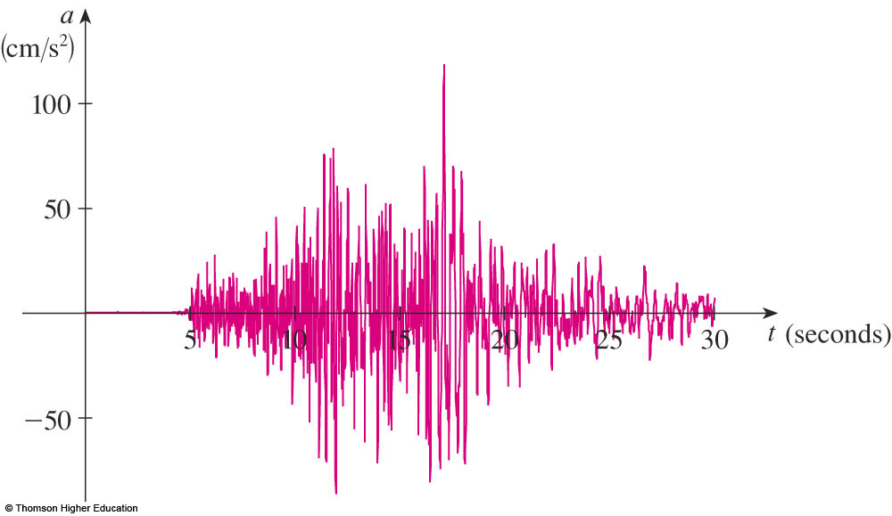
Functions and Their Representations
D. The vertical acceleration a of the ground as measured by a seismograph during an earthquake is a function of the elapsed time t. The figure shows a graph generated by seismic activity during the Northridge earthquake that shook Los Angeles in 1994. For a given value of t, the graph provides a corresponding value of a.

Slide 7
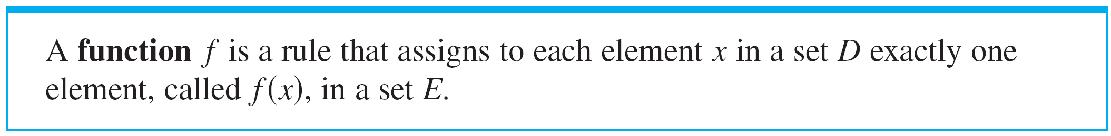
Functions and Their Representations
Both examples describes a rule whereby, given a number (r, t ), another number (A, P ) is assigned. In each case we say that the second number is a function of the first number.
We usually consider functions for which the sets D and E are sets of real numbers. The set D is called the domain of the function. The number f (x) is the value of f at x and is read “ f of x.”

Slide 8
Functions and Their Representations
The range of f is the set of all possible values of f (x) as x varies throughout the domain.
A symbol that represents an arbitrary number in the domain of a function f is called an independent variable.
A symbol that represents a number in the range of f is called a dependent variable.

Slide 9
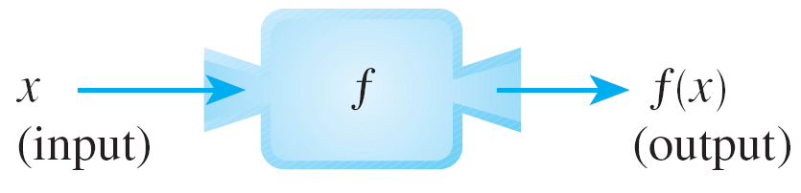
Functions and Their Representations
It’s helpful to think of a function as a machine (see Figure 2).
Machine diagram for a function ƒ
Figure 2

Slide 10
Functions and Their Representations
If x is in the domain of the function f, then when x enters the machine, it’s accepted as an input and the machine produces an output f (x ) according to the rule of the function.
Thus we can think of the domain as the set of all possible inputs and the range as the set of all possible outputs.

Slide 11
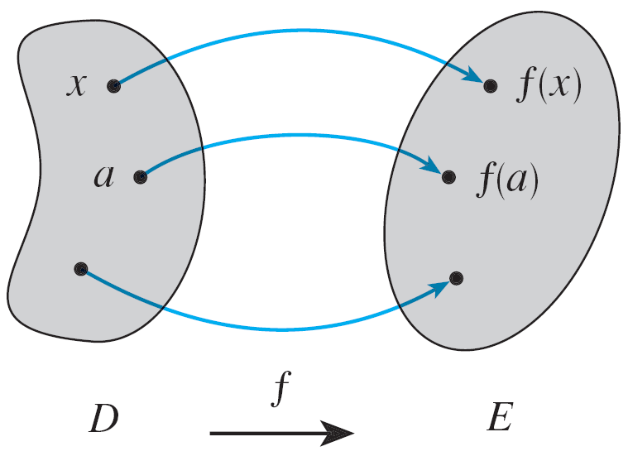
Functions and Their Representations
Another way to picture a function is by an arrow diagram as in Figure 3.
Arrow diagram for ƒ
Figure 3

Slide 12

Functions and Their Representations
Each arrow connects an element of D to an element of E. The arrow indicates that f (x ) is associated with x, f (a) is associated with a, and so on.
The most common method for visualizing a function is its graph. If f is a function with domain D, then its graph is the set of ordered pairs
The graph of a function f gives us a useful picture of the behavior or “life history” of a function.

Slide 13
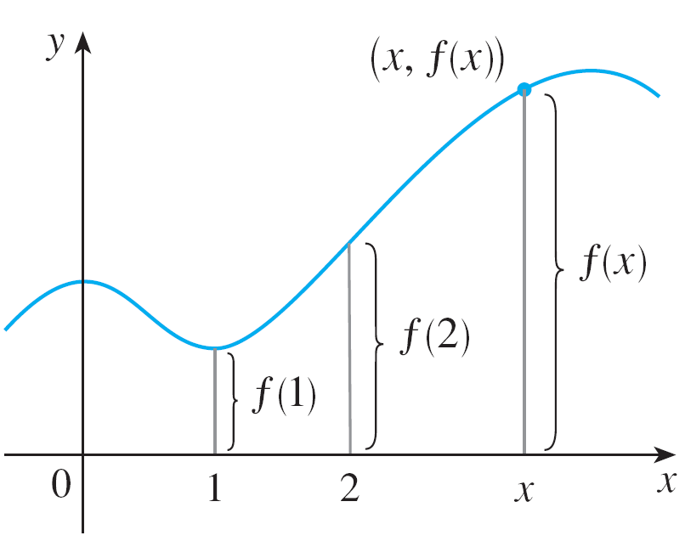
Functions and Their Representations
Since the y-coordinate of any point (x, y) on the graph is y = f (x), we can read the value of f (x) from the graph as being the height of the graph above the point x. (See Figure 4.)
Figure 4

Slide 14
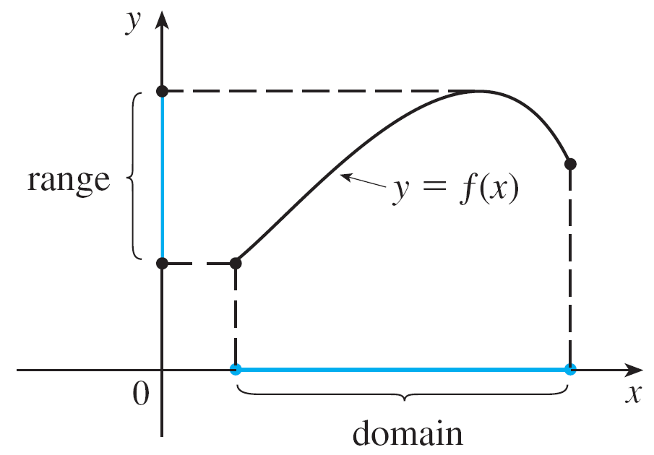
Functions and Their Representations
The graph of f also allows us to picture the domain of f on the x-axis and its range on the y-axis as in Figure 5.
Figure 5

Slide 15
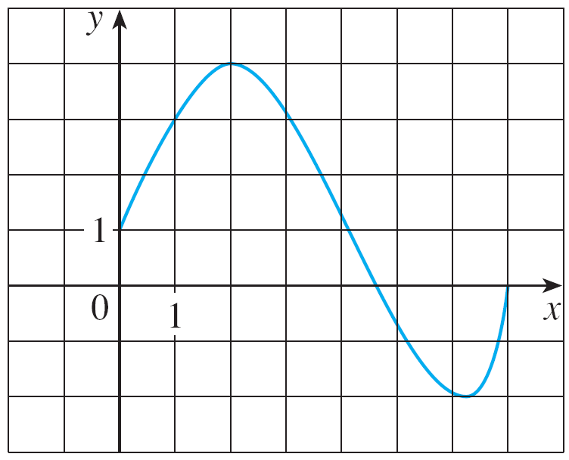
Example 1
The graph of a function f is shown in Figure 6.
(a) Find the values of f (1) and f (5).
(b) What are the domain and range of f ?
Figure 6

Slide 16

Example 1 – Solution
(a) We see from Figure 6 that the point (1, 3) lies on the graph of f, so the value of f at 1 is f (1) = 3. (In other words, the point on the graph that lies above x = 1 is 3 units above the x-axis.)
When x = 5, the graph lies about 0.7 unit below the x-axis, so we estimate that f (5) ≈ –0.7.
(b) We see that f (x) is defined when 0 ≤ x ≤ 7, so the domain of f is the closed interval [0, 7]. Notice that f takes on all values from –2 to 4, so the range of f is

Slide 17
Representations of Functions

Slide 18
Representations of Functions
There are four possible ways to represent a function:
verbally (by a description in words)
visually (by a graph)
numerically (by a table of values)
algebraically (by an explicit formula)

Slide 19
Representations of Functions
If a single function can be represented in all four ways, it is often useful to go from one representation to another to gain additional insight into the function.
But certain functions are described more naturally by one method than by another.
With this in mind, let’s reexamine the two situations that we considered at the beginning of this section.

Slide 20

Representations of Functions
A. The most useful representation of the area of a circle as a function of its radius is probably the algebraic formula A (r) = π r ², though it is possible to compile a table of values or to sketch a graph (half a parabola). Because a circle has to have a positive radius, the domain is and the range is also .
B. We are given a description of the function in words: P (t ) is the human population of the world at time t.
Let’s measure t so that t = 0 corresponds to the year 1900.

Slide 21
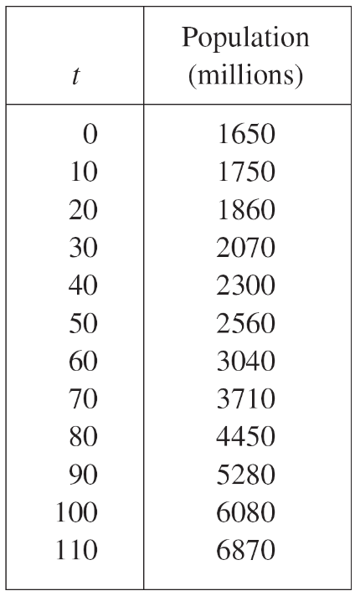
Representations of Functions
The table of values of world population provides a convenient representation of this function.

Slide 22
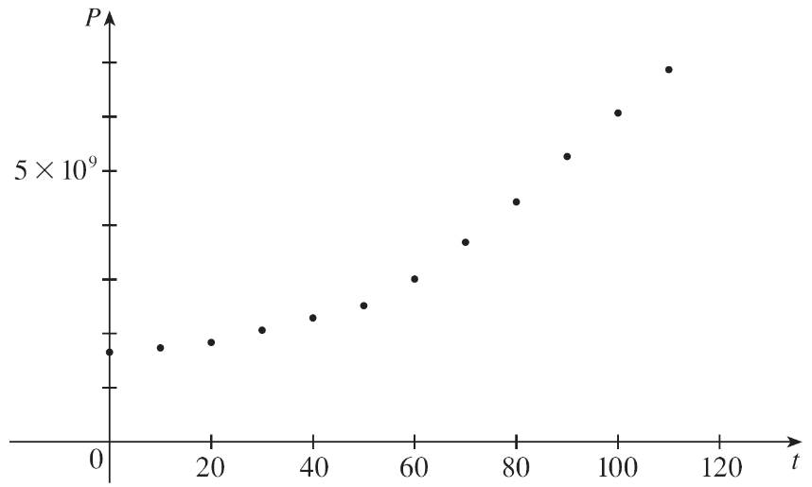
Representations of Functions
If we plot these values, we get the graph (called a scatter plot) in Figure 7.
Scatter plot of data points for population growth
Figure 7

Slide 23
Representations of Functions
It is possible to find an expression for a function that approximates P (t ), we could use a graphing calculator with exponential regression capabilities to obtain the approximation.

Slide 24
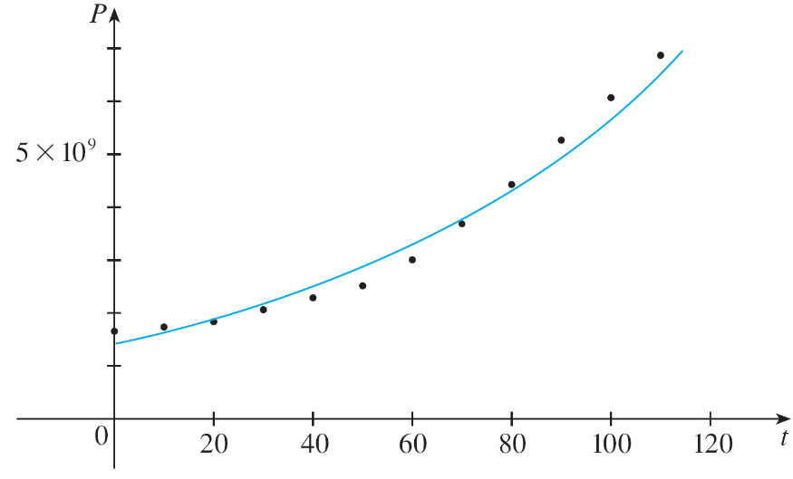
Representations of Functions
Figure 8 shows that it is a reasonably good “fit.” The function f is called a mathematical model for population growth.
Graph of a mathematical model for population growth
Figure 8

Slide 25
Representations of Functions
In other words, it is a function with an explicit formula that approximates the behavior of our given function.
The function P is typical of the functions that arise whenever we attempt to apply calculus to the real world.
We start with a verbal description of a function. Then we may be able to construct a table of values of the function, perhaps from instrument readings in a scientific experiment.

Slide 26
Example 2
When you turn on a hot-water faucet, the temperature T of the water depends on how long the water has been running. Draw a rough graph of T as a function of the time t that has elapsed since the faucet was turned on.
Solution:
The initial temperature of the running water is close to room temperature because the water has been sitting in the pipes.
When the water from the hot water tank starts flowing from the faucet, T increases quickly.

Slide 27
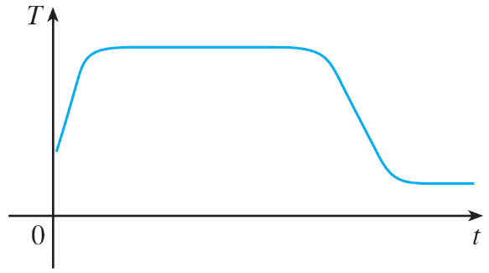
Example 2 – Solution
cont’d
In the next phase, T is constant at the temperature of the heated water in the tank. When the tank is drained, T decreases to the temperature of the water supply. This enables us to make the rough sketch of T as a function of t in Figure 9.
Figure 9

Slide 28
Example 3
Find the domain of each function.
(a)
(b)

Slide 29
Example 3(a) SOLUTION
The square root of a negative number is not defined (as a real number). So, the domain of f consists of all values of x such that
This is equivalent to .
So, the domain is the interval .

Slide 30
Example 3(b) SOLUTION
Since and division by 0 is not allowed, we see that g(x) is not defined when x = 0 or x = 1. Thus, the domain of g is . This could also be written in interval notation as .

Slide 31
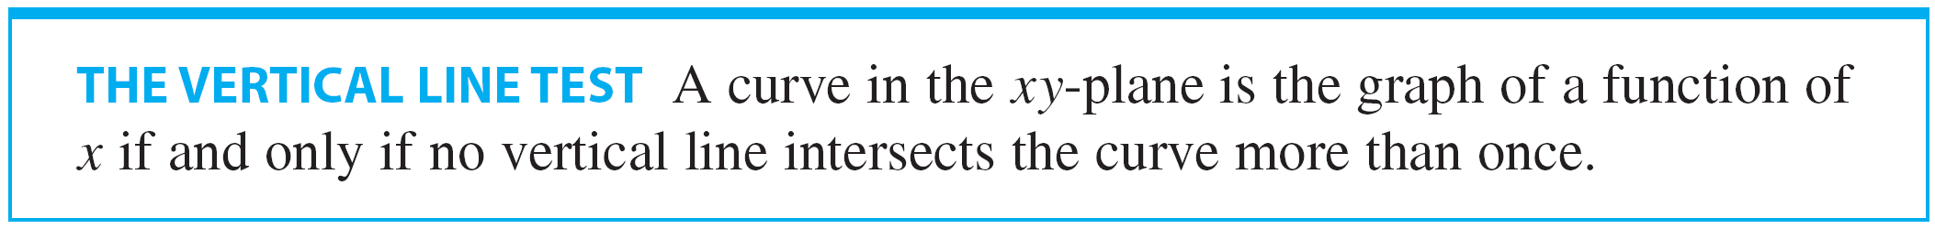
Representations of Functions
The graph of a function is a curve in the xy-plane. But the question arises: Which curves in the xy-plane are graphs of functions? This is answered by the following test.

Slide 32
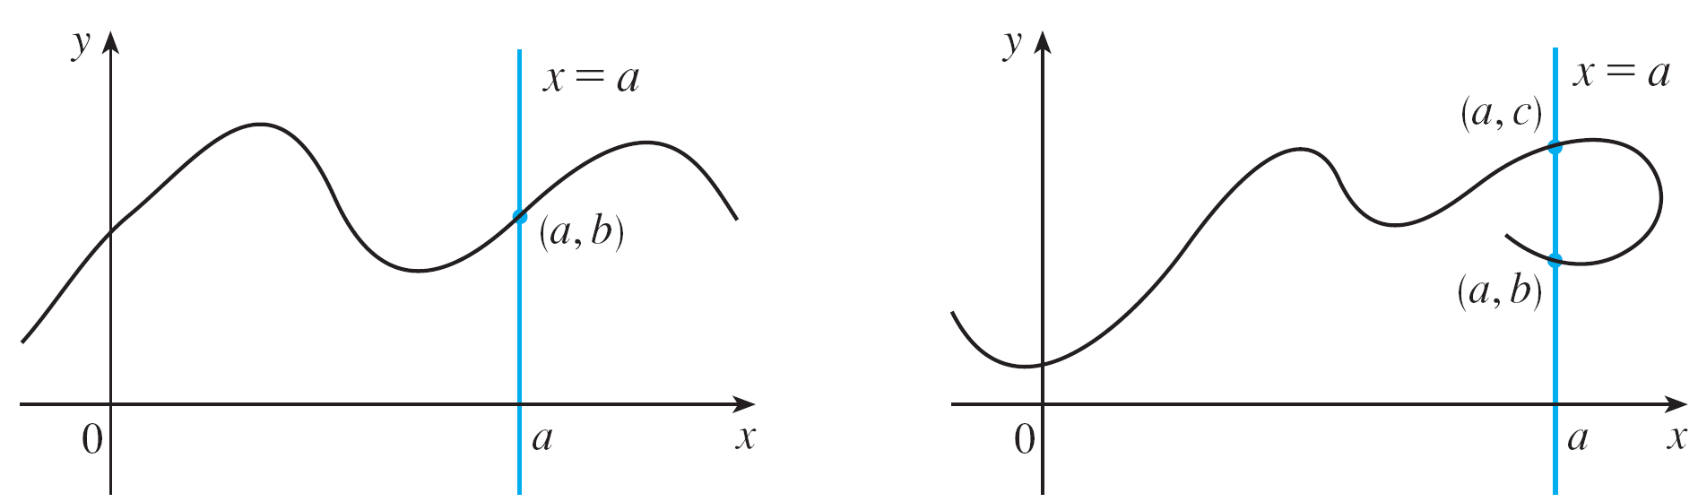
Representations of Functions
The reason for the truth of the Vertical Line Test can be seen in Figure 10.
Figure 10

Slide 33
Representations of Functions
If each vertical line x = a intersects a curve only once, at (a, b), then exactly one functional value is defined by f (a) = b.
But if a line x = a intersects the curve twice, at (a, b) and (a, c), then the curve can’t represent a function because a function can’t assign two different values to a.

Slide 34
Piecewise Defined Functions

Slide 35
Example 4
A function f is defined by: Evaluate f(0), f(1), and f(2) and sketch the graph.

Slide 36
Example 4 SOLUTION
Remember that a function is a rule. For this particular function, the rule is:
First, look at the value of the input x.
If it happens that x ≤ 1, then the value of f(x) is 1 – x.
In contrast, if x > 1, then the value of f(x) is x².
Thus
Since 0 ≤ 1, we have f(0) = 1 – 0 = 1.
Since 1 ≤ 1, we have f(1) = 1 – 1 = 0.
Since 2 > 1, we have f(2) = 2² = 4.

Slide 37
Example 4 SOLUTION
How do we draw the graph of f ?
If x ≤ 1, then f(x) = 1 – x. So, the part of the graph of f that lies to the left of the vertical line x = 1 must coincide with the line y = 1 – x, which has slope -1 and y-intercept 1.
If x > 1, then f(x) = x². So, the part of the graph of f that lies to the right of the line x = 1 must coincide with the graph of y = x², which is a parabola.
This enables us to sketch the graph as follows.

Slide 38
Example 4 SOLUTION
The solid dot indicates that the point (1, 0) is included on the graph.
The open dot indicates that the point (1, 1) is excluded from the graph.

Slide 39


Piecewise Defined Functions
The absolute value of a number a, denoted by , is the distance from a to 0 on the real number line.
Distances are always positive or 0, so we have
for every number
For example,
a .

Slide 40
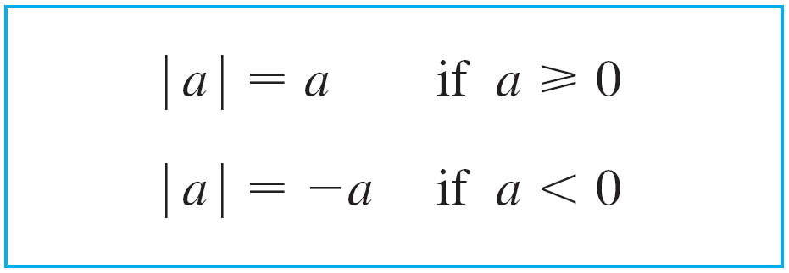
Piecewise Defined Functions
In general, we have
(Remember that if a is negative, then – a is positive.)

Slide 41

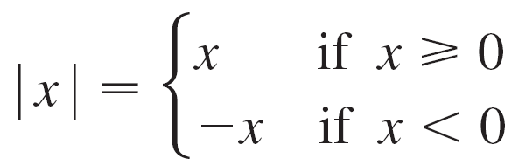
Example 5
Sketch the graph of the absolute value function
Solution::
From the preceding discussion we know that
Remember that a function is a rule.
For this particular function the rule is the following: First look at the value of the input x. If it happens that x ≥ 0 then value of f (x) is x. On the other hand, if x < 0, then the value of f (x) is –x.

Slide 42
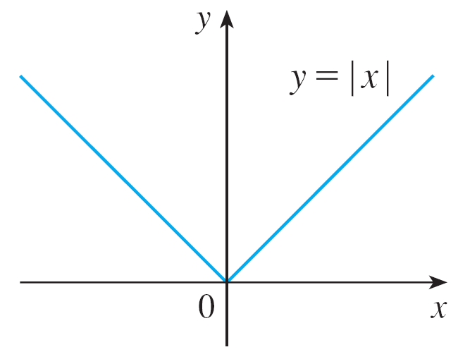
Example 5 – Solution
cont’d
We see that the graph of f coincides with the line y = x to the right of the y-axis and coincides with the line y = –x to the left of the y-axis (see Figure 12).
Figure 12

Slide 43
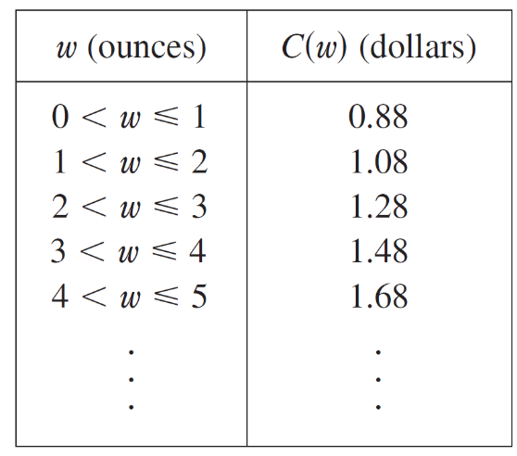
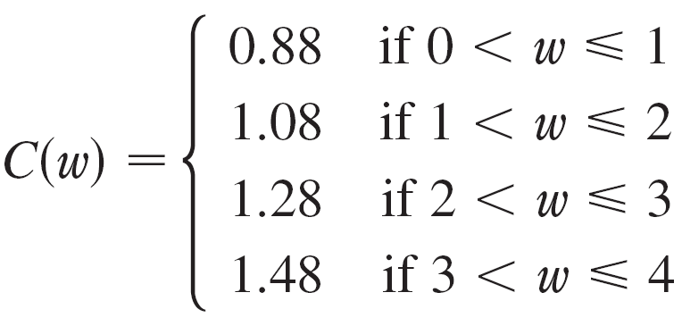
Example 6
Consider C (w ) be a cost of mailing a large envelope with weight w. In effect, this is a piecewise defined function because, from the table of values below, we have

Slide 44
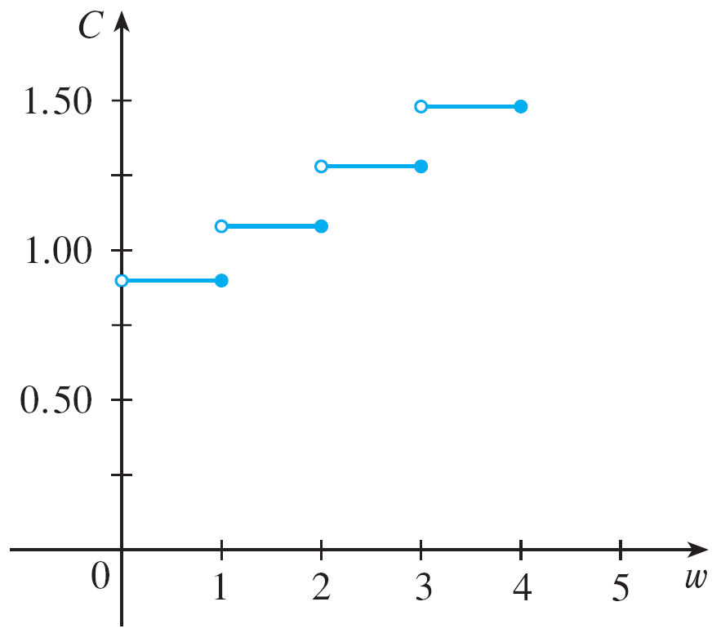
Example 6
cont’d
The graph is shown in Figure 13. You can see why functions similar to this one are called step functions: they jump from one value to the next.
Figure 13

Slide 45
Symmetry

Slide 46
Symmetry
If a function f satisfies f (–x ) = f (x ) for every number x in its domain, then f is called an even function.
For instance, the function f (x ) = x ² is even because

Slide 47
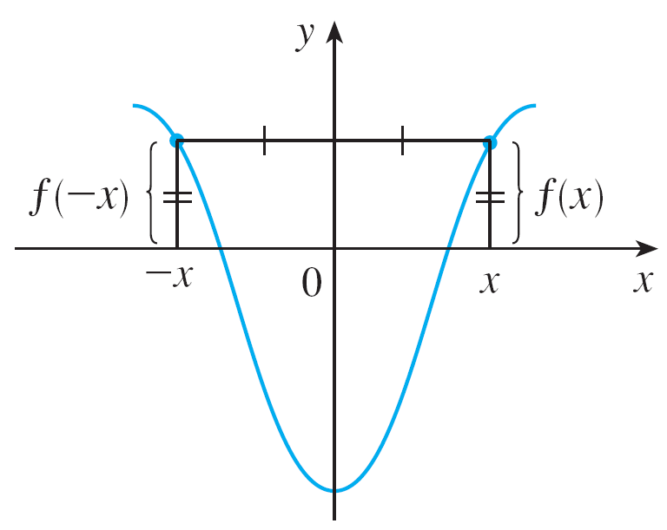
Symmetry
The geometric significance of an even function is that its graph is symmetric with respect to the y -axis (see Figure 14).
An even function
Figure 14

Slide 48
Symmetry
This means that if we have plotted the graph of f for x ≥ 0, we obtain the entire graph simply by reflecting this portion about the y-axis.
If f satisfies f (–x) = –f (x) for every number x in its domain, then f is called an odd function.
For example, the function f (x) = x³ is odd because

Slide 49
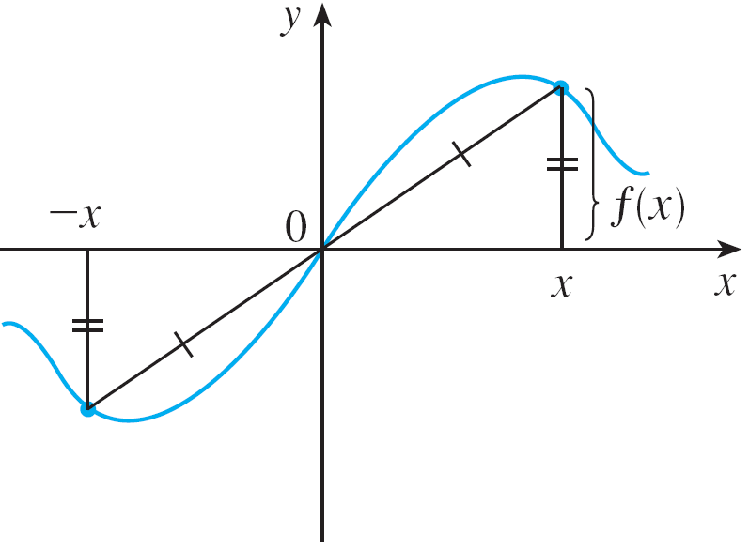
Symmetry
The graph of an odd function is symmetric about the origin (see Figure 15). If we already have the graph of f for x ≥ 0, we can obtain the entire graph by rotating this portion through 180° about the origin.
An odd function
Figure 15

Slide 50
Example 7
Determine whether each of the following functions is even, odd, or neither even nor odd.
(a)
(b)
(c)

Slide 51
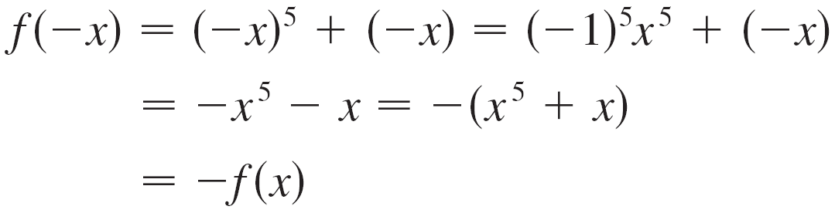
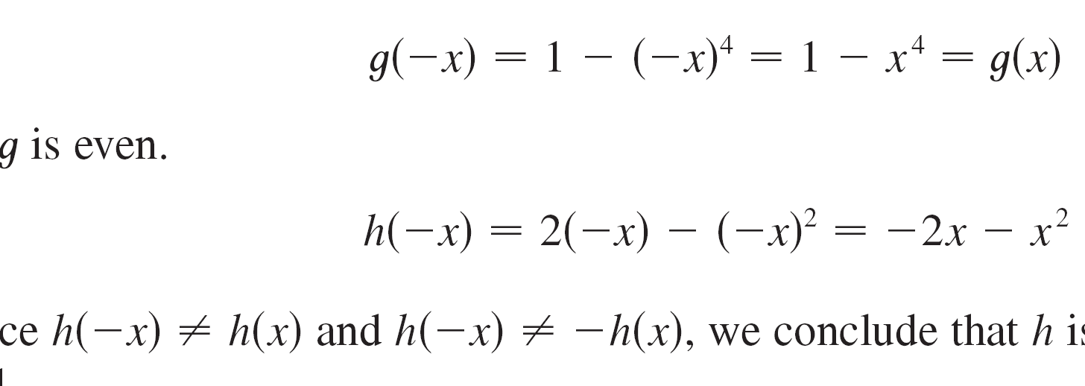

Example 7 – Solution
(a)
Therefore ,f is an odd function.
(b)
So, g is even.

Slide 52
Example 7 – Solution
cont’d
(c)
Since and , , we conclude that h is neither even nor odd.

Slide 53
Symmetry
(a)
(b)
(c)
Figure 16
The graphs of the functions in Example 7 are shown in Figure 16. Notice that the graph of h is symmetric neither about the y-axis nor about the origin.

Slide 54
Increasing and Decreasing
Functions

Slide 55
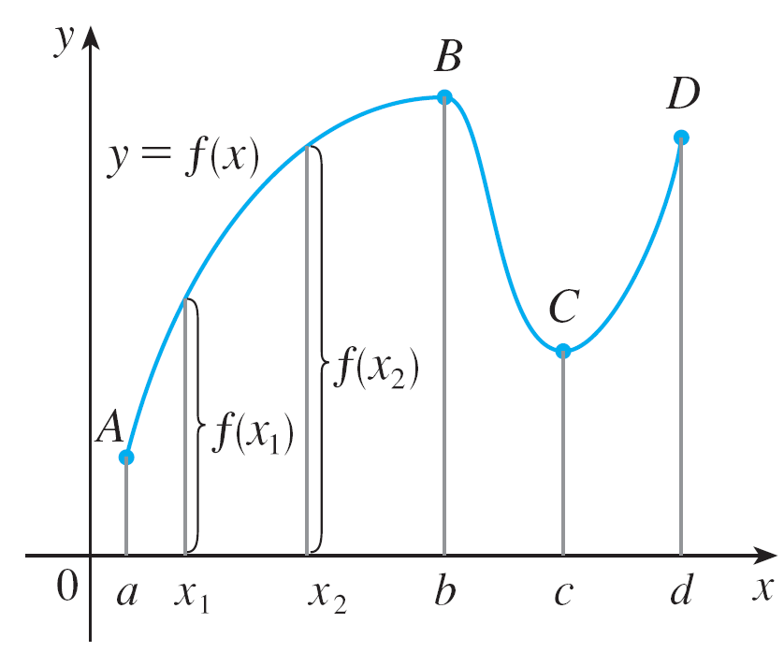
Increasing and Decreasing Functions
The graph shown in Figure 17 rises from A to B, falls from B to C, and rises again from C to D.
Figure 17

Slide 56
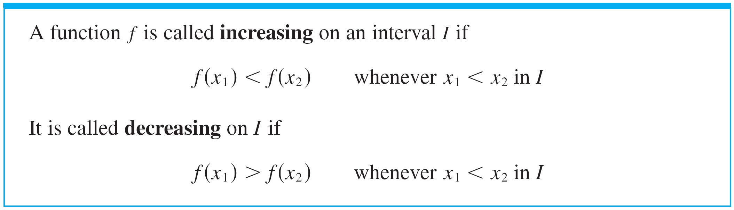
Increasing and Decreasing Functions
The function f is said to be increasing on the interval [a, b ], decreasing on [b, c ], and increasing again on [c, d ].
Notice that if x₁ and x₂ are any two numbers between a and b with x₁ < x₂, then f (x₁) < f (x₂). We use this as the defining property of an increasing function.

Slide 57
Increasing and Decreasing Functions
In the definition of an increasing function it is important to realize that the inequality f (x₁) < f (x₂) must be satisfied for every pair of numbers x₁ and x₂ in I with x₁ < x₂.

